Slide 1
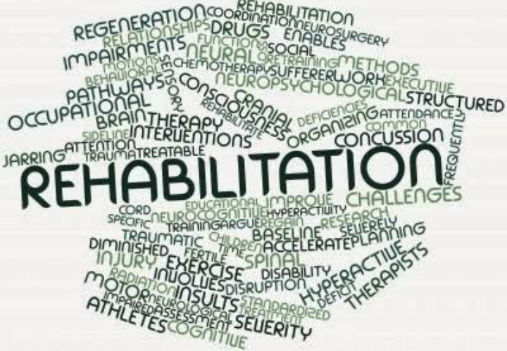
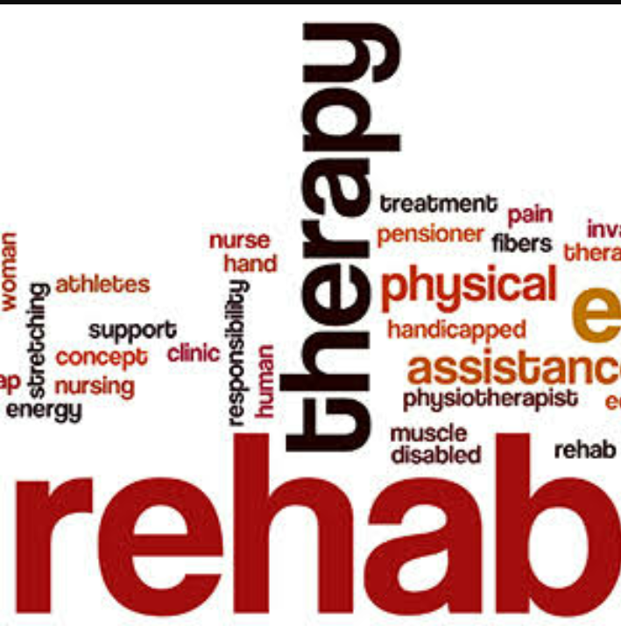
REHABILITATION PSYCHOLOGY

Slide 2
TOPIC :INTERVENTIONS OF SPEECH AND LANGUAGE DISORDER

Slide 3
CONTENTS
INTRODUCTION
SPEECH DISORDER
ASSESSMENT AND INTERVENTION OF SPEECH DISORDER
ASSESSMENT AND INTERVENTION OF ARTICULATION DISORDER
ASSESSMEMT AND INTERVENTION OF FLUENCY DISORDER
ASSESSMENT AND INTERVENTION OF NEUROLOGICAL DAMAGE
ASSESSMENT AND INTERVENTION OF LANGUAGE DISORDER
CONCLUSION
REFERENCES

Slide 4
INTRODUCTION
The speech disorders include disorders of voice, articulation, and fluency.
Therapy for voice problems usually involves 4 steps when the problem is misuse or abuse of the voice.
Child intervention program will depend on the child’s age ,other developmental characteristics ,and the type and consistency of the articulatory disorders.
An interventions plan must take into consideration the content, from and use of language.

Slide 5
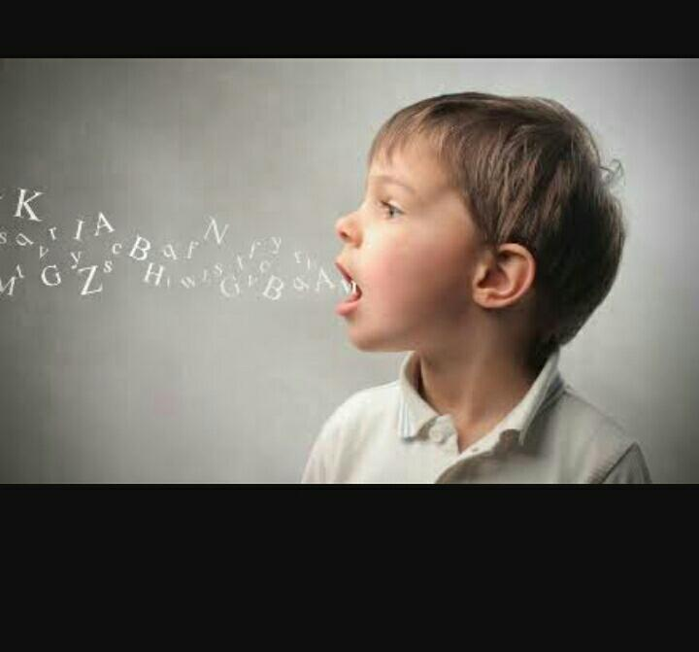
SPEECH DISORDER
DEFINITION OF SPEECH DISORDER
“It is a condition in which a person has problems creating or forming speech sounds needed to communicate with others”.
There are 3 common speech disorders:
Articulation disorder
Fluency disorder
Voice disorder

Slide 6
ASSESSMENT AND INTERVENTIONS OF SPEECH DISORDER
When children are screened for speech and language disorder.
The speech language pathologist is on the lookout for problems in voice quality, resonance, pitch and loudness.
Medical report may indicate that surgery or other treatment is needed because of a growth or infection.
Therapy for voice problems usually involves these steps when the problem is misuse or abuse of the voice
Identify vocal misuses and abuses.
Reduce vocal misuses and abuses.
Search with the patient for the best voice he or she can produce.
Employ various approaches to maintain the optimum voice.

Slide 7
ASSESSMENT AND INTERVENTIONS OF ARTICULATION DISORDER
Difficulties in specific types of sounds.
Treatment : speech therapy.
Parents of preschool children may refer their child for assessment if he or she has speech that is difficult to understand.
Speech - language pathologist will assess not only phonological characteristics , but also the child’s social and developmental history, hearing, general language ability, and speech mechanism.
Intervention for a child who has severely delayed speech usually begins in the preschool or early elementary grades.

Slide 8
The children's and adults are sometimes seek help for themselves when their speech draws negative attention.
The decision whether or not to include the child in an intervention program will depend on many things they are:
Child’s age
Other developmental characteristics
The type and consistency of the articulatory errors.
The once sounds are reliably produced correctly in a clinical setting ,the focus of interventions shifts to transfer of the training to the everyday environment.

Slide 9
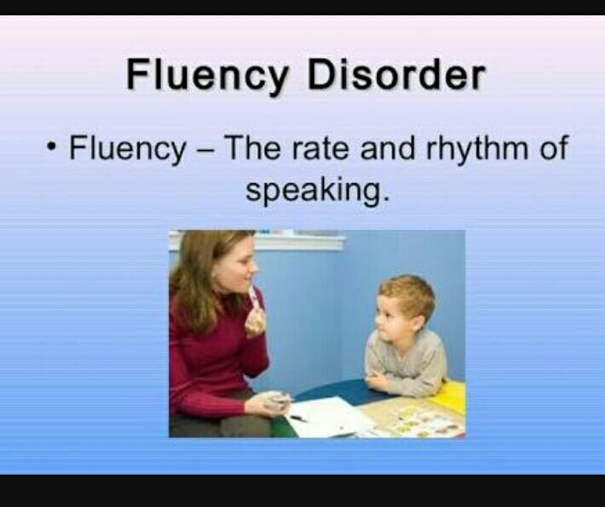
ASSESMENTS AND INTERVENTION OF FLUENCY DISORDER
Interventions too must be an interdisciplinary efforts.
Dentists, Audiologists, Psychologist, and speech –language pathologists are part of the team required for adequate assessment and interventions.
Child who has an or facial defect will be similar in many respects to work with children , who have phonological voice or other disorder.
No defect of the speech mechanism.

Slide 10

ASSESSMENT AND INTERVENTION OF NEUROLOGICAL DAMAGE
The disorder of the nervous system.
The neurologically Impaired individual’s ability to control breathing, phonation, resonation ,and articulatory movements.
Medical , surgical ,and rehabilitative specialists in the treatment of neurological disorder.
Neurological disorder must evaluate the persons problem and plan a management strategy.

Slide 11
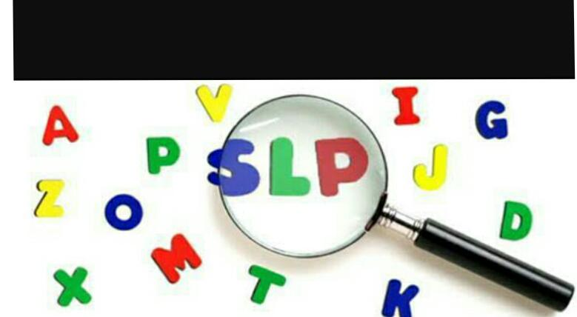
ASSESSMENT AND INTERVENTION OF LANGUAGE DISORDER
It involves the processing of linguistic information.
Out of 3 one must consider :
What the child talks about and should be taught to talk about
How the child talks about things and he or she could be taught to speak of those things more intelligibly.
How the child uses language and how his or her use of it, the purposes of communication and socialization more effectively.
Language interventions must occur in the child’s natural environment and involve parents and classroom teachers ,not just the speech language pathologist.

Slide 12
CONCLUSION
Language disorder children obviously have not learned in the normal way and since research is beginning to indicate that different sequences of learning may be more effective.
Language disorders is based on the Presumed cause or related conditions.
Parents of preschool children may refer their child for assessment if he or she has speech that is really difficult to understand.
And also the normal speech is characterised by some interruption in speech flow,
Advances in the diagnosis of young stutterers have made possible the distinction between children who will outgrow the disfluency without intervention and children who will require therapy.

Slide 13
REFERENCES
Hallahan , D.P & Kauffman , T.M.,1988. Exceptional children .prentice Hall ,
Englewood cliffs , New Jersey.
www.https ://in.pintrest .com.
http:// www- usr.edu/ interventions of speech and language disorder.

Slide 14


